Slide 1
  Advance Java
  MVC
LEVEL – PRACTITIONER

Slide 2
About the Author
Created By: | Renjith(t-renjith)/ Shanmu (105110)
Credential Information: | Trainer/ Sr Architect
Version and Date: | 1.0, January 21’st 2012
Cognizant Certified Official Curriculum
Notes:
For tde animators:
tdis screen content needs to be rendered in tde flash, no animations needed.

Slide 3









Icons Used
Hands on Exercise
Questions
Tools
Coding Standards
Test Your Understanding
Case Study
Best Practices & Industry Standards
Demonstration
Workshop

Slide 4
Objectives
After completing this chapter you will be able to understand:
  What is MVC pattern?
  Advantages of MVC.
  How to implement MVC using servlets/JSP?

Slide 5
A New Kind of Problem.
James is a software engineer . His client has approached to him to create a graphic intensive web application whose graphics will change very often . Also the client is planning to change the data base server after two years so the application must be flexible to the above changes stated.
How can James create an application addressing the below problems,
Problem # 1 : Rich Graphics which a web designer can develop independent of application business logic development?
Problem # 2 : Application business logic changes should not impact the web design and graphics?
Problem # 3: Application flexible for any future data base change without impacting the web design?
James applied Model View Controller (MVC) design

Slide 6
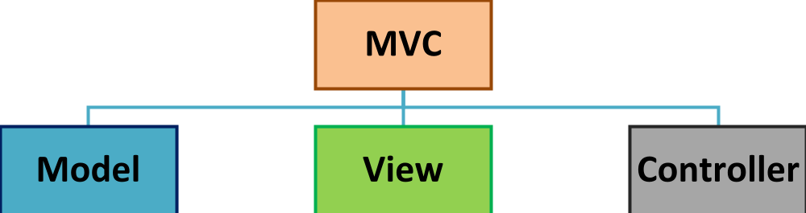
What is MVC?
MVC stands for Model View Controller
MVC separates an application into three logical areas,
Model encapsulates the core data and application business logic.
Example: Java class performing data access (or) business logic.
View, This layer represents the presentation of data. Typically the JSP which renders the data in different formats.
Example: JSP rendering data in multiple formats.
    Controller, used for controlling the flow of data between the model and view.
    Example: Servlets which controls the request responses.

Slide 7
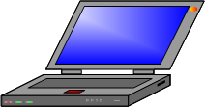
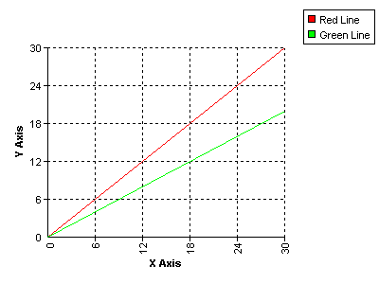
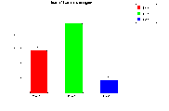
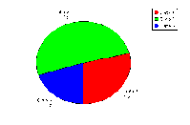
How MVC works?
Step 1 The Controller Servlet handles the user’s request
Client
CONTROLLER (SERVLET)
Step 4: The controller then
transfers the data to the View.
Step 2: The Controller Servlet then invokes the Model and performs the business logic (or) data retrieval.
View
Step 5: The View renders the data in
the appropriate
format requested
by the client.
Model
(Java, EJB, Spring)
Business Logic/
Retrieves Data
Step 3: The model returns back the data (response) back to the controller.
Data

Slide 8
Benefits of MVC
Clear Separation of layers, modular & easy to maintain.
Example: The model holds business logic/ data manipulation logic & View holds the presentation logic. System is modular and easy to maintain as developer know which logic is present in which layer.
Supports parallel development so reduces development time.
Example: The view and model can be developed by different teams and finally integrated. This reduces development time to market.
Highly flexible for future enhancements.
Example: Any changes done like database upgradation or change in business logic it is enough if the model is changed without changing the view or controller.

Slide 9
How James solved the problem?
James developed his system as illustrated below and solved his problems.
Solved the problem # 1 web designer can develop independent of application business logic development
Solved the problem # 2 & 3 The business/ data base changes not impacting the view.
He embedded all the graphic design in the View layer.
He used a controller to separate graphics design and business logic/Data.
View
C
O
N
T
R
O
L
L
E
R
Model
(Java, EJB, Spring)
Business Logic/
Retrieves Data
Data

Slide 10
Lend a Hand – MVC Pattern
Requirement: Consider as an initial task James is going to create a registration form for the user’s. There is only one business logic the client has given – the age of the registering user should be between 18-60 and this validation should be done in the server side only. James decided to build the application using MVC pattern . Here are the components to be developed,
registration.jsp : The Registration Page for the users (View).
RegistrationController : The controller Servler (Controller)
User bean Class : Model to store user data (Model)
UserDao Class : Contains the logic for the data base operations. (Model)
RegistrationBO : The business class for the application which encapsulates the entire business logic.
success.jsp to show the success screen
error.jsp to show the error message in case of any exception thrown by the model/controller.

Slide 11
Lend a Hand - Pre-Requisite
Prerequisites:
Create a table <EmployeeId>_ User in oracle database with the following columns,
Where, <EmployeeId> is the employee id of the associate, this is to ensure everyone have their own tables created.
firstName - varchar(25)
lastName -varchar(25)
password -varchar(25)
age -Number
address - varchar(50)
gender - varchar(12)
country - varchar(15)

Slide 12
Lend a Hand – Exception Handling
In addition to the MVC components James also decided to create two exception classes to handle the exceptions arising in the application.
1. RegistrationBusinessException : To be thrown in case of any business validation error . For example can be thrown in case the age entered by the user is less than 18 (or) greater than 60.
2. RegistrationException : Used to wrap all the exception such as SQLException and other runtime exceptions other than the business exception.

Slide 13
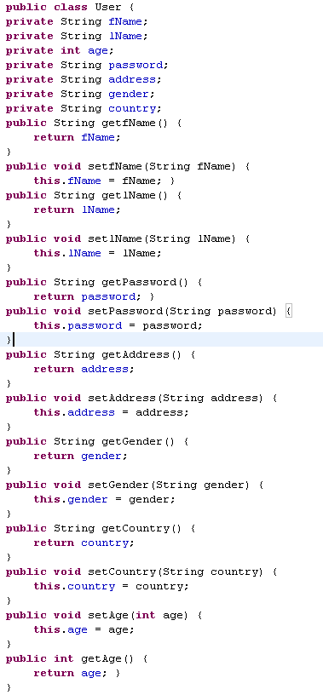
Lend a Hand – Develop the User Bean
This has all the parameter that needs to be stored when user registers.

Slide 14
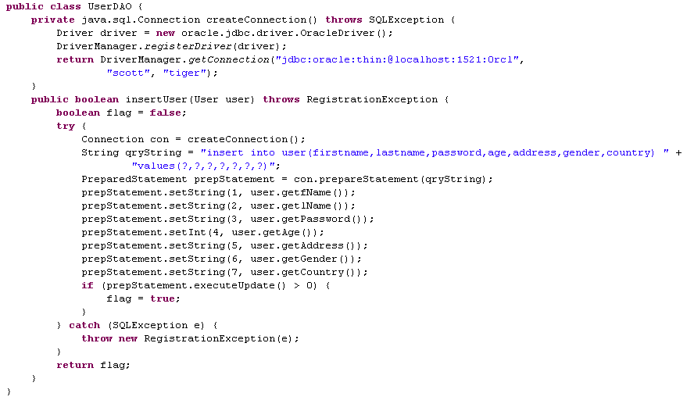
Lend a Hand – Develop the Model ( UserDAO)
The database driver and URL to be changed according to the database in use
Table name changed as per the associates employee id.
Database create connection is implemented in a separate method for reusing.
Get the values from User Bean and set it in the prepared statement.
SQL Exception caught and thrown as RegistrationException

Slide 15
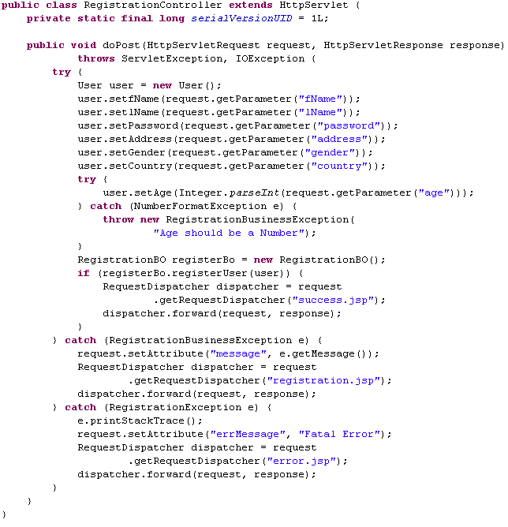
Lend a Hand – Develop The Controller (Registration Controller)
Reads the parameters and sets to bean object
Handles the NumberFormatException which may thrown during integer conversion and throws a business exceptions
Calls the RegisterBO to do the user validation and perform the database insertions and when insertion is success forwards the request to success.jsp
Handles the business exception and the request is forwarded to the registration page with error message set as attribute to the request object
Handles all other exceptions and forwards to error.jsp

Slide 16
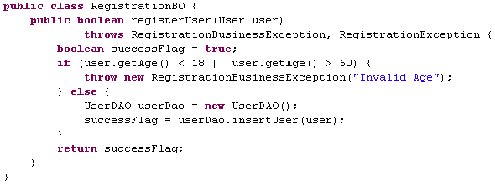
Lend a Hand – The business class - RegistrationBO
Throws business when age<18 or age>60
Creates the UserDAO object and calls the insertUser() method to insert the user data into the database.

Slide 17
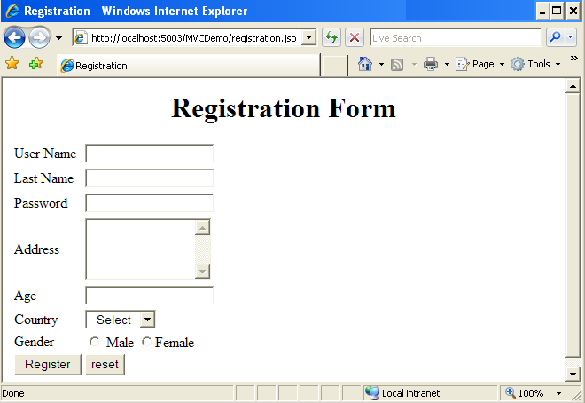
Lend a Hand : Registration Page Design
This is the design for the registration page.

Slide 18
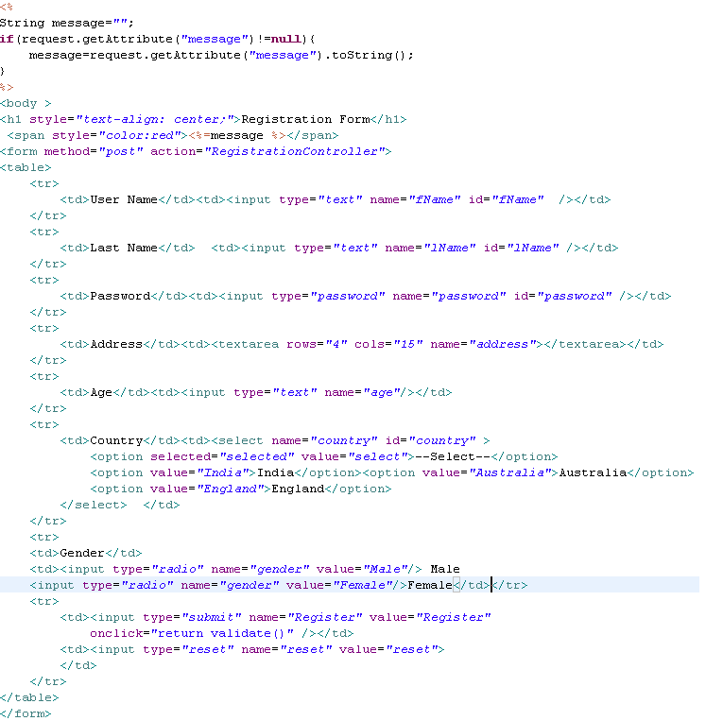
Lend a Hand : Develop the View (Registration Page)
Reads the age validation (> 18 & <60) error message in the request object if any.
This prints only the business validation error message. The other exceptions are redirected to the error page by the controller.

Slide 19
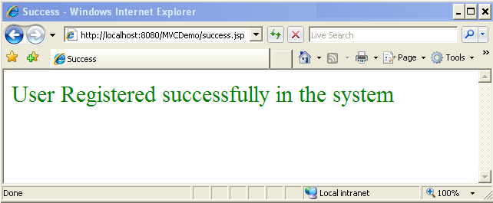
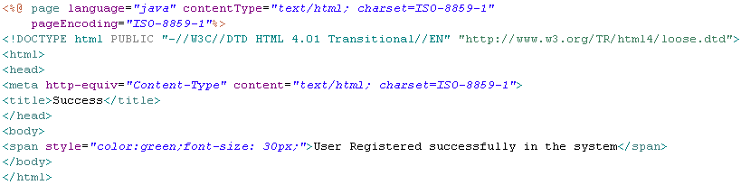
Lend a Hand : Develop Success View (success.jsp )

Slide 20
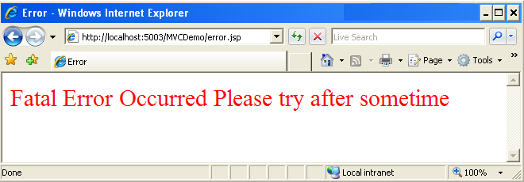
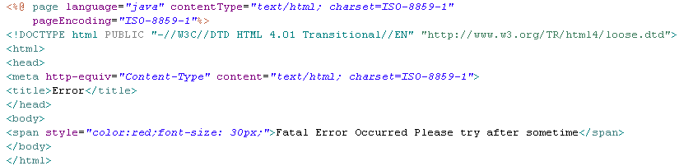
Lend a Hand- Develop Error View (Error.jsp)

Slide 21
Lend a Hand – Deploy and Run
Step 1 : Deploy and run the application.
Step 2 : Invoke registration.jsp from the browser
http://localhost:/MVCDemo/registration.jsp
Step 3 : Enter valid input and press register. You should be forwarded to success page.
Step 4 : Enter age value greater than 60 or below 18 . Should get an error message “invalid age” on the registration page.

Slide 22
  Advance Java
  You have successfully completed –
  MVC Session

